Slide 1
ADDERS
Arithmetic circuits are the central building blocks of computers.
Computers and digital logic perform many arithmetic functions: addition, subtraction, comparisons, shifts, multiplication, and division
Addition is one of the most common operations in digital systems.
We first consider how to add two 1-bit binary numbers. We then extend to
N-bit binary numbers

Slide 2

WEEK3 PROGRAM 1 HALF ADDER
Aim of the Experiment:
Design and Implementation of a Full adder using
Basic Gates

Slide 3
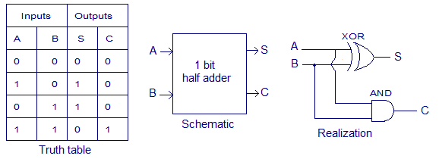
Half adder
A half-adder shows how two bits can be added together with a few simple logic gates.
A single half-adder has two one-bit inputs, a sum output, and a carry-out output.
module halfadd(a, b,sum, cout);
input a, b;
output sum, cout;
xor2 x0(---------);
and2 a0(--------);
endmodule

Slide 4
Half Adder Test Bench halfadder_tb.v
module halfadd_tb;
reg aa,bb;
wire ss,cy;
halfadd add1(.a(aa), .b(bb), .sum(ss), .cout(cy));
initial
begin
$dumpfile("halfadd_test.vcd");
$dumpvars(0, halfadd_tb);
end

Slide 5
initial
begin
$monitor($time, "a=%b, b=%b, sum=%b, carry=%b", aa, bb, ss, cy);
aa = 1'b0;bb = 1'b0;
#5 aa = 1'b0;bb = 1'b1;
#5 aa = 1'b1;bb = 1'b0;
#5 aa = 1'b1;bb = 1'b1;
end
endmodule

Slide 6
Simulation
iverilog -o test1 halfadder.v half_adder_tb.v
vvp test1
gtkwave halfadder_test.vcd

Slide 7
WEEK3 PROGRAM 2 FULL ADDER
Aim of the Experiment:
Design and Implementation of a Full adder using
Half Adders

Slide 8
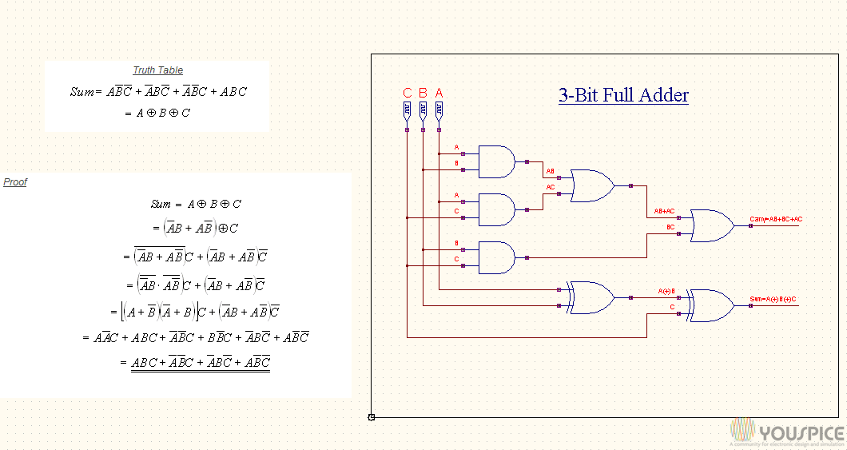
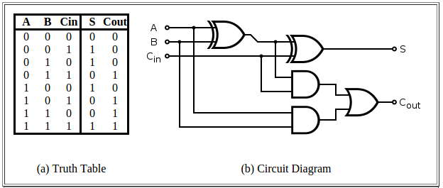
Full Adder
t[1]
t[4]
cout
t[2]
t[3]
t[0]
t[0]
sum
cin

Slide 9
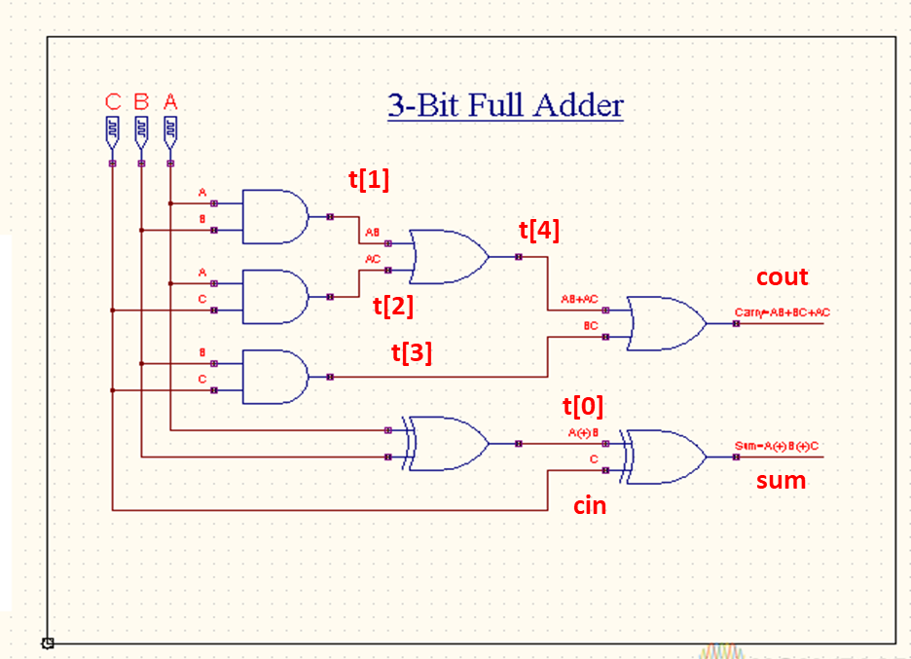
Full Adder Verilog File fulladd.v
module fulladd(input wire a, b, cin, output wire sum, cout);
wire [4:0] t;
xor2 x0(----------);
xor2 x1(---------);
and2 a0(----------);
and2 a1(-----------);
and2 a2(-----------);
or2 o0(------------);
or2 o1(-----------t);
endmodule

Slide 10
Full Adder Test Bench fulladd_tb.v
module fulladd_tb;
reg aa,bb,cc;
wire ss,cy;
fulladd add1(.a(aa), .b(bb), .cin(cc), .sum(ss), .cout(cy));
initial
begin
$dumpfile("fulladd_test.vcd");
$dumpvars(0, fulladd_tb);
end
initial
begin
$monitor($time, "a=%b, b=%b, c=%b,sum=%b,carry=%b",aa,bb,cc,ss,cy);

Slide 11
Full Adder Test Bench( Cont.…..)
aa = 1'b0;bb = 1'b0;cc=1'b0;
#5 aa = 1'b0;bb = 1'b0;cc=1'b1;
#5 aa = 1'b0;bb = 1'b1;cc=1'b0;
#5 aa = 1'b0;bb = 1'b1;cc=1'b1;
#5 aa = 1'b1;bb = 1'b0;cc=1'b0;
#5 aa = 1'b1;bb = 1'b0;cc=1'b1;
#5 aa = 1'b1;bb = 1'b1;cc=1'b0;
#5 aa = 1'b0;bb = 1'b1;cc=1'b1;
end
endmodule

Slide 12
Full Adder Simulation (using basic gates)
Students have to complete the fulladd.v file
Execution Steps
Step1) iverilog -o test2 basic.v fulladder.v fulladder_tb.v
If the compilation went OK, you won't see any output. What this does is create a file called testfa that we can feed to the simulator.
Step2) vvp test2
You can observe output on the console
Step3) gtkwave fulladder_test.vcd
Output waveform will be observed.

Slide 13
WEEK3 PROGRAM 3 RIPPLE CARRY ADDER
Aim of the Experiment:
Design and Implementation of a Ripple Carry Adder using
Full Adders

Slide 14
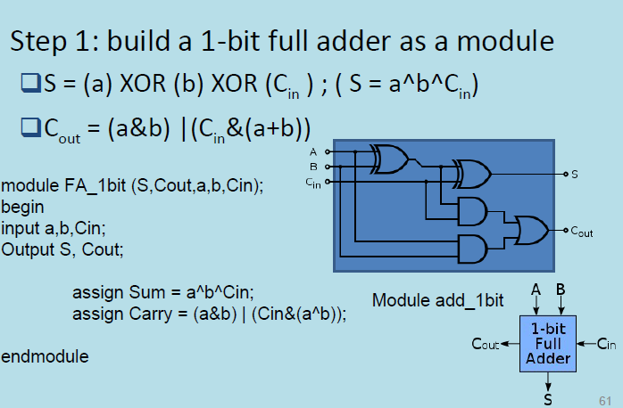
4-bit Ripple Carry Adder

Slide 15
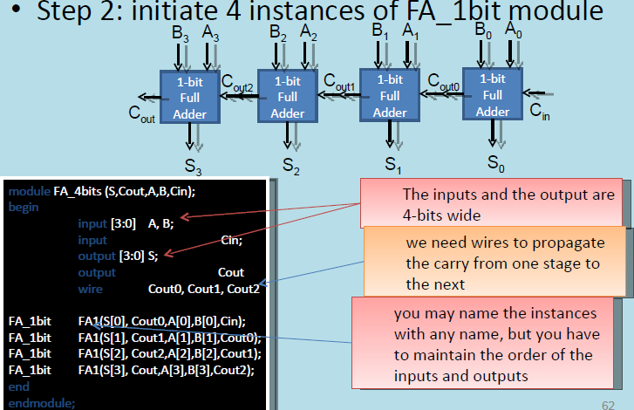
4-bit Ripple Carry Adder

Slide 16
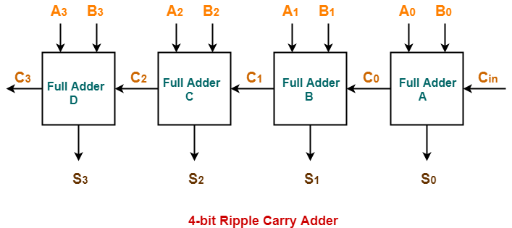

Slide 17
4-bit Ripple Carry Adder Verilog File rca.v
// Module 4-bit ripple carry adder
module fulladdR(input wire [3:0] a, b, input wire cin, output wire [3:0] sum, output wire cout);
// Instantiate full adder modules here
wire [2:0] c;
fulladd u0 (----------------------);
fulladd u1 (----------------------);
fulladd u2 (---------------------);
fulladd u3 (---------------------);
endmodule

Slide 18
4-bit Ripple Carry Adder Testbench rca_tb.v
`timescale 1 ns / 100 ps
`define TESTVECS 10
module tb;
reg clk, reset;
reg [3:0] i0, i1;
reg cin;
wire [3:0] o;
wire cout;
reg [8:0] test_vecs [0:(`TESTVECS-1)];
integer i;
initial
begin
$dumpfile("rca_test.vcd");
$dumpvars(0,tb);
end

Slide 19
initial
begin
reset = 1'b1; #12.5 reset = 1'b0; end initial clk = 1'b0; always #5 clk =~ clk;
initial begin
test_vecs[0] = 9'b000000000;
test_vecs[1] = 9'b000000001;
test_vecs[2] = 9'b000100010;
test_vecs[3] = 9'b000100011;
test_vecs[4] = 9'b001000100;
test_vecs[5] = 9'b001000101;
test_vecs[6] = 9'b101010110;
test_vecs[7] = 9'b101010111;
test_vecs[8] = 9'b111011110;
test_vecs[9] = 9'b111011111;
end

Slide 20
initial {i0, i1, cin, i} = 0;
fulladdR u0 (i0, i1, cin, o, cout);
initial begin #6
for(i=0;i<`TESTVECS;i=i+1)
begin #10 {i0, i1, cin}=test_vecs[i];
end #100 $finish; end
always@(i0 or i1 or cin)
$monitor("At time = %t, i0=%b, i1=%b,cin=%b,Sum = %b,Carry %b", $time,i0,i1,cin,o,cout);
endmodule

Slide 21
4-bit Ripple Carry Adder Truth Table
 | a3 | a2 | a1 | a0 | b3 | b2 | b1 | b0 | cin
 | I0[3] | I0[2] | I0[1] | I0[0] | I1[3] | I1[2] | I1[1] | I1[0] | cin | Sum[3:0] | cout
TESTVECTOR[0] | 0 | 0 | 0 | 0 | 0 | 0 | 0 | 0 | 0 | 0+0+0=
TESTVECTOR[1] | 0 | 0 | 0 | 0 | 0 | 0 | 0 | 0 | 1 | 0+0+1=
TESTVECTOR[2] | 0 | 0 | 0 | 1 | 0 | 0 | 0 | 1 | 0 | 1+1+0=
TESTVECTOR[3] | 0 | 0 | 0 | 1 | 0 | 0 | 0 | 1 | 1 | 1+1+1=
TESTVECTOR[4] | 0 | 0 | 1 | 0 | 0 | 0 | 1 | 1 | 0 | 2+3+0=
TESTVECTOR[5] | 0 | 0 | 1 | 0 | 0 | 0 | 1 | 1 | 1 | 2+3+1=
TESTVECTOR[6] | 1 | 0 | 1 | 0 | 1 | 0 | 1 | 1 | 0 | A+B+0=
TESTVECTOR[7] | 1 | 0 | 1 | 0 | 1 | 0 | 1 | 1 | 1 | A+B+1=
TESTVECTOR[8] | 1 | 1 | 1 | 0 | 1 | 1 | 1 | 1 | 0 | E+F+0=
TESTVECTOR[9] | 1 | 1 | 1 | 0 | 1 | 1 | 1 | 1 | 1 | E+F+1 =

Slide 22
Ripple carry adder)
Step1) iverilog -o testrca basicfa.v rca.v rca_tb.v
If the compilation went OK, you won't see any output.
Step2) vvp testrca
You can observe output on the console
Step3) gtkwave rca_test.vcd
Output waveform will be observed

